Slide 1
Understand and Reimagine React Reporting Framework
Presented By
MBA Summer Interns (CE-LOB)
Aman Sagar (A8511)
Ajaya Saipriya Sahoo (A8529)
Presenting to
Sahil Mahajan, Vicky Thakur, Sharanya Sable
Date: 07-May-2025

Slide 2

Introduction
Overview: Need of React Reporting Framework
Current Components of React Reporting Framework and Modifications
Insights from Different Business Teams and Identified Gaps in React Report
Suggestions for Component Repository
Identified UI/UX Issues
Conclusion
Agenda

Slide 3
Overview: Recap of Previous Work
Identified Gaps in React Report
Suggested Modifications and Components
Exploring Tableau and Power BI
Visual Mockups
Understanding IC Implementation
Conclusion
Agenda

Slide 4
Introduction
Current Goals
Understand the need of React Reporting Framework
Compare with Power BI reports and Identify Gaps
Connect with Business Teams to understand variations
Idea for a framework that could serve atleast 80% of the needs and reduce implementation time by 60%

Slide 5







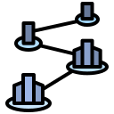
Overview
Need of React Reporting Framework
The Framework: To generate Incentive Compensation (IC) reports using React.js and Highcharts
React.js is an open-source JavaScript library for building user interfaces and Highcharts is a charting library that provides a wide variety of interactive charts and graphs.
Simplified and Declarative Syntax
Cost-Effective
Fast Rendering
Active Community with extensive resources available
Component Based Architecture
Why React.js?
Flexible and Highly Customizable
Look and Feel
Scalable

Slide 6
Current Components of React Reporting Framework and Modifications
Goalcard and Scorecard reports only
Component | Use Case
Header Section 1 | Report Title, Logos, Reporting period , User information
Header Section 2 | Different View tabs – My view , Team view etc.
RHS panel | Specific content about report
Additional Notes | To display list of additional notes
Insights | To display insights of report
Data Table | To render table with various interactive features
Chart | To display various charts using highcharts
Suggested Modifications:
Download as PDF/PPT option.
Save view option for multiple layouts and filters in report itself.
Switcher option in charts to switch between supported chart types like bar chart to pie etc.
Chart and table separate download option.
In-component chart inferences.
Smart alerts displayed on charts if some major change is being displayed .

Slide 7
Overview
Recap of Previous Work
React Reporting Framework: Needs and Current Components
Identified gaps include some variations w.r.t. Power BI reports and UI/UX bugs/ improvements
Proposed Improvements include:
Some modifications in the current components
Addition of new components

Slide 8
Suggestions for Component Repository
New Component | Report Type | Use Case | Benefit
Comparison Matrix | Scorecard and Goalcard | Multi row , multi column matrix for structured comparisons among teams , sales rep , territory wise. | Help client to make effective decision by evaluating differences
Calendar Heatmap | Scorecard | Daily activity of sales like red color code for poor sales and green for good given the range | Impact Goals, helps in decision making , help spotting patterns
Feedback component/Helpdesk | Scorecard and Goalcard | Analyst Observations, Manager inputs , Cross functional comments, User Grievance | Helps in collaboration
Goal Tracker | Goalcard | Visually track target against actuals – bar with reference line | Helps stakeholders monitor goal progress
Translate component (Known issue) | Scorecard and Goalcard | Multilingual support for reports | Enabling clients/users to view reports in their preferred language
Map (Known issue) | Scorecard | Display region wise sales, performance scores | Help display data across geographies

Slide 9
Suggestions for Component Repository (Cont.)
New Component | Report Type | Use Case | Benefit
Editable Data Table | Goalcard | Managers adjust goals for different month in a quarterly report | Ensures real-time update as per the requirement
Tooltip | Scorecard/Goalcard | Hover over button to see what it does | Ensures the clarity of buttons used
Autocomplete | Scorecard | Search tab provides available suggestions | Prevents free-text errors
Drag and Drop | Scorecard/Goalcard | Reorganize data table by dragging rows | Ease of updating rows (than using query for filtering)

Slide 10
Suggested Modification and Components
Goalcard and Scorecard reports only
Suggested Modifications
Download as PDF/PPT option.
Suggested Components
Comparison Matrix
Calendar Heatmap
Feedback Component/Helpdesk
Save view option for multiple layouts and filters in report itself.
Switcher option in charts to switch between supported chart types like bar chart to pie etc.
Chart and table separate download option.
In-component chart inferences.
Smart alerts displayed on charts if some major change is being displayed
Goal Tracker
Translation Component
Map
Editable Data Table
Tooltip
Auto-complete
Drag and Drop

Slide 11
Exploring Tableau & Power BI: Feature Integration Opportunities in React Framework
Component/Feature | Tool | Use Case
Forecasting & Predictive Analytics | Tableau | Forecast future trends using historical data to support strategic planning and data-driven decision-making.
Hierarchical Based Access | Tableau | Integrates all user-role reports into one, with hierarchical access—higher roles view broader data; lower roles see limited scopes.
AI-Powered Prompt Charts | Tableau | Users customize charts by entering prompts to an AI bot, enabling fast, tailored visualizations without manual configuration.
Viz in Tooltip (Viz in Viz) | Tableau | Hovering reveals mini visualizations for deeper insights without leaving the main chart view.
Mini Bars within cell of table | Power BI | Embed visual bars in table cells to enable quick, in-cell comparison of data across rows.
Sync Slicer | Power BI | Apply consistent filters across multiple tabs for unified, seamless data exploration and comparison.
Data Masking | Power BI | Protect sensitive data by masking specific fields in tables, ensuring privacy without compromising overall insights.

Slide 12
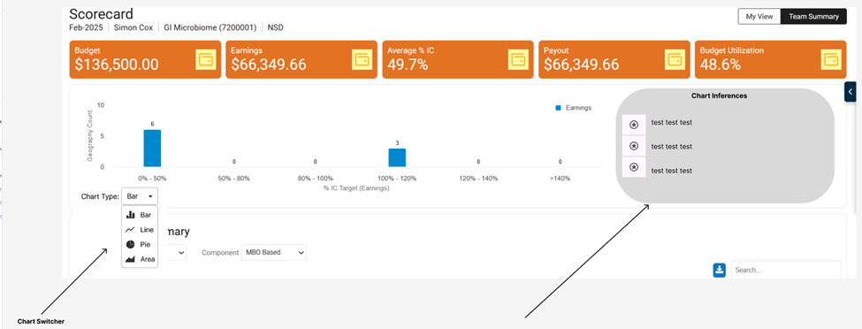
Visual Mockups - Chart Features
Tools
Chart Switcher
Chart Inference

Slide 13
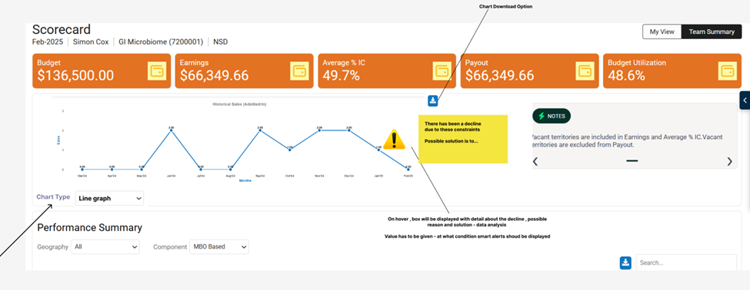
Visual Mockups - Chart Features (Cont.)
Tools

Slide 14
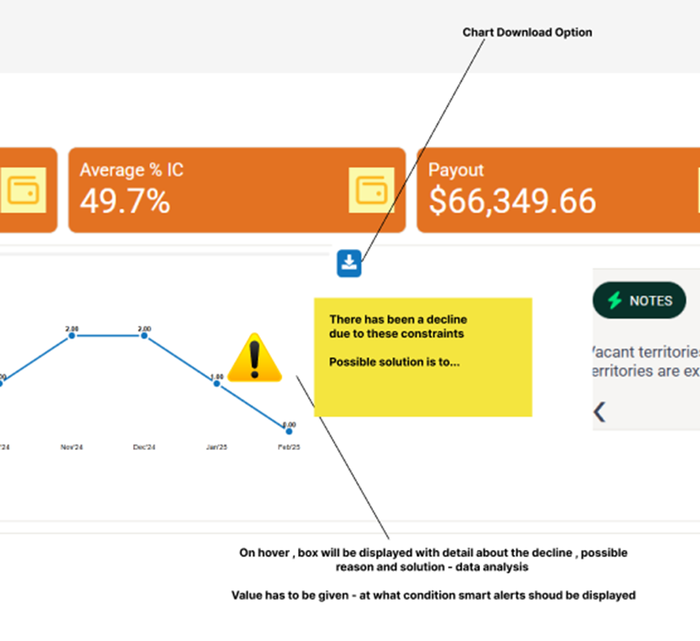
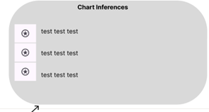
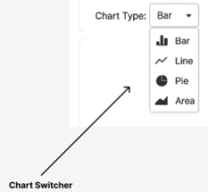


Visual Mockups - Chart Features (Cont.)
Tools

Slide 15
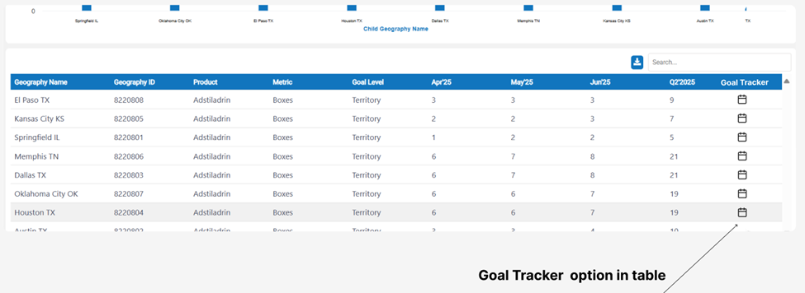
Visual Mockups - Calendar Heatmap & Goal Tracker
Tools
On clicking to the calendar icon in table, User will navigate to Goal tracker and calendar heatmap screen.

Slide 16
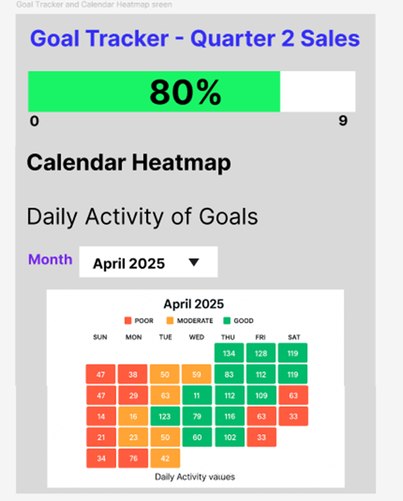
Visual Mockups - Calendar Heatmap & Goal Tracker (Cont.)
Tools

Slide 17
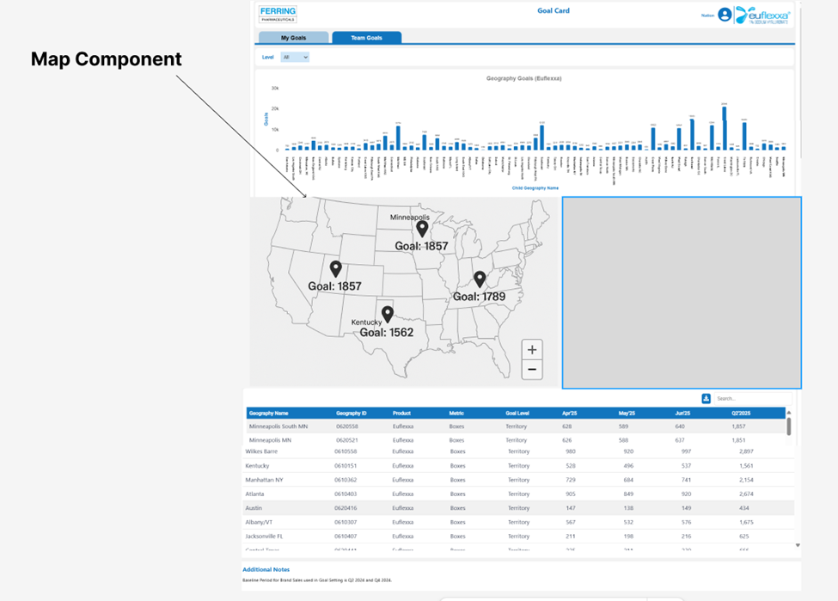
Visual Mockups - Map Component
Tools

Slide 18
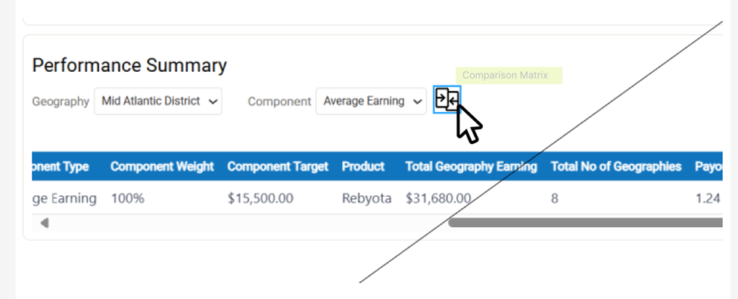
Visual Mockups - Comparison Matrix and Tooltip Feature
Tools
Tooltip and Comparison Matrix icon

Slide 19
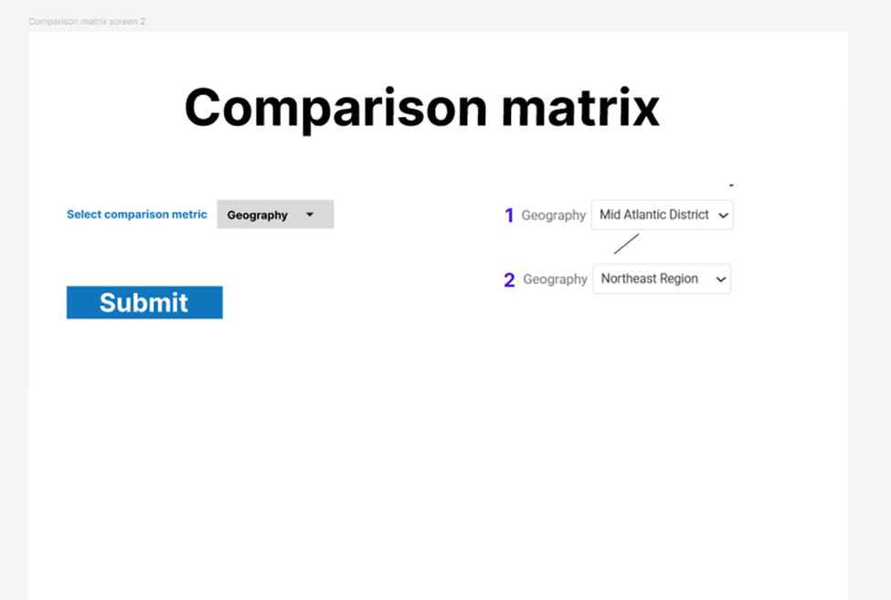
Visual Mockups - Comparison Matrix and Tooltip Feature (Cont.)
Tools
On clicking to comparison matrix icon, this screen opens.
Comparison matrix screen 1

Slide 20
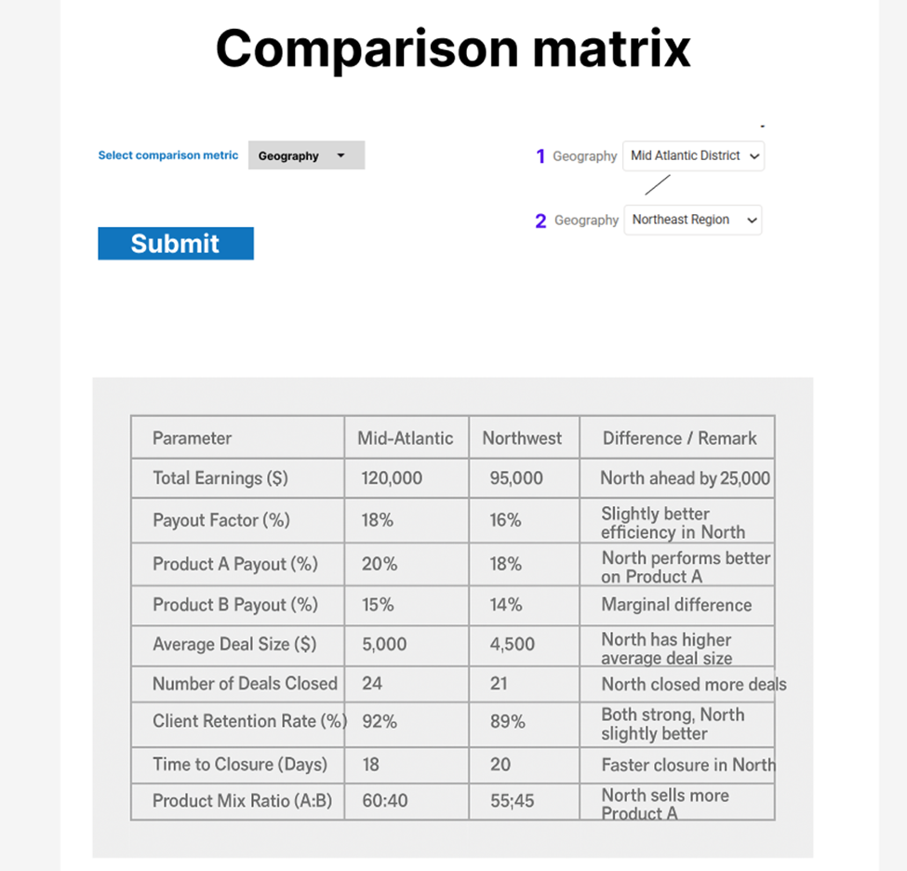
Visual Mockups - Comparison Matrix and Tooltip Feature (Cont.)
Tools
Comparison matrix screen 2 - After submitting screen

Slide 21
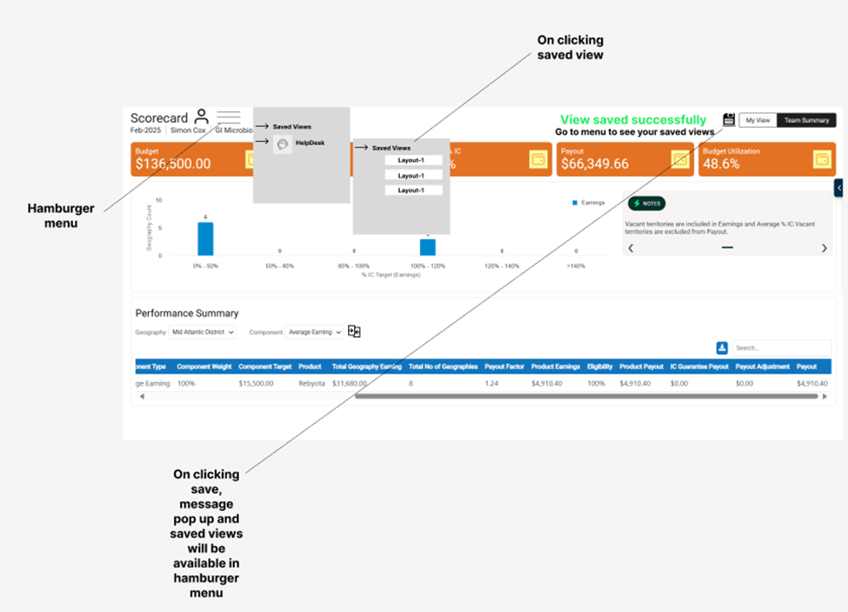
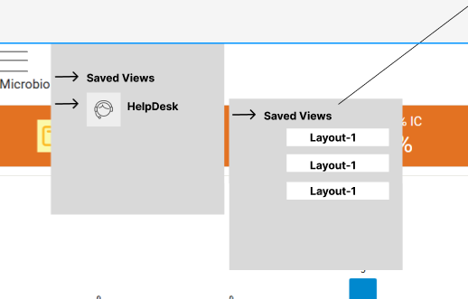
Visual Mockups - Saved View and Helpdesk (Hamburger Menu)
Tools

Slide 22
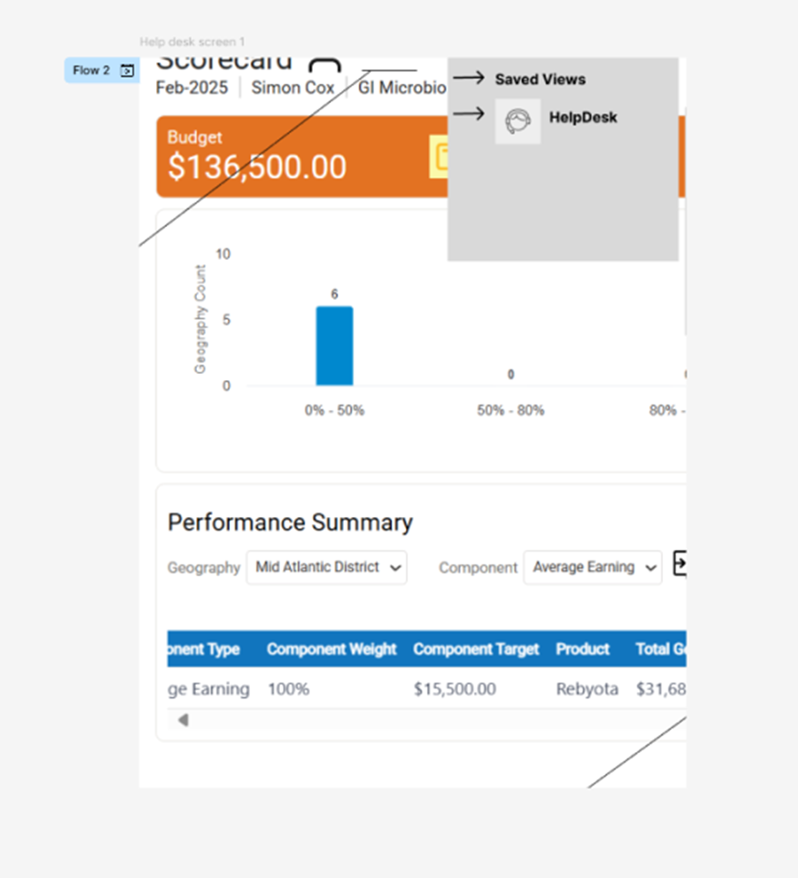
Visual Mockups - Saved View and Helpdesk (Hamburger Menu) (Cont.)
Tools
Help desk in hamburger menu

Slide 23
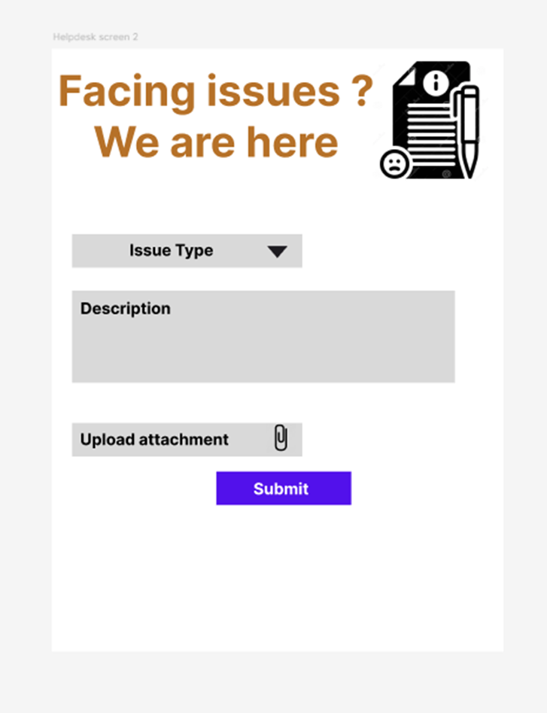
Visual Mockups - Saved View and Helpdesk (Hamburger Menu) (Cont.)
Tools
Helpdesk Screen 2 (It opens when user clicks on helpdesk in hamburger menu)

Slide 24
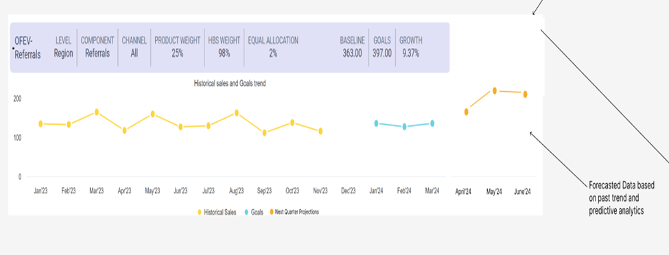
Visual Mockups - Forecasting and Predictive Analytics
Tools
Forecasted data based on past trends and predictive analytics

Slide 25
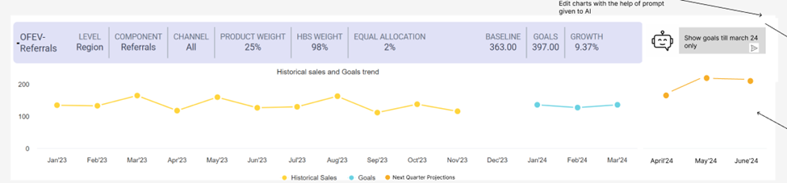
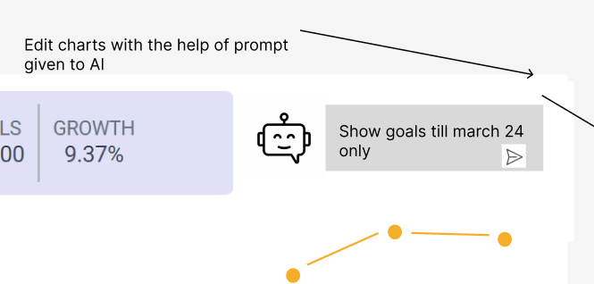
Visual Mockups - Generate Customized Chart with AI
Tools
Screen 1 – Prompt given to AI

Slide 26
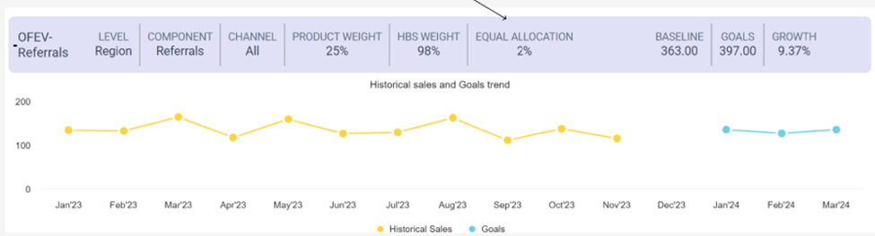
Visual Mockups - Generate Customized Chart with AI (Cont.)
Tools
Screen 2 – Chart changed as per prompt given to AI bot

Slide 27
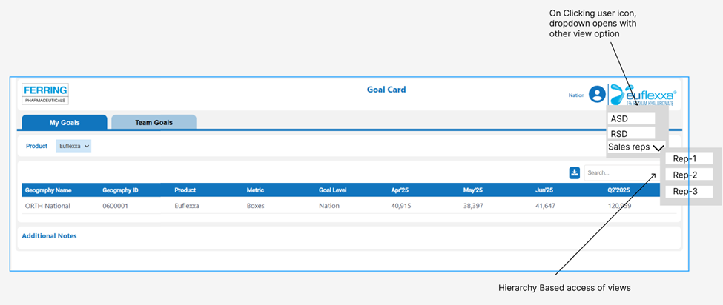
Visual Mockups - Role Based Access
Tools
Hierarchy Based access view

Slide 28
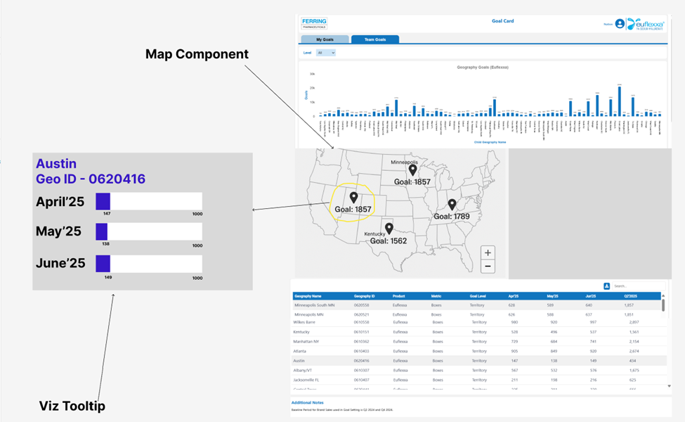
Visual Mockups - Viz Tooltip
Tools

Slide 29
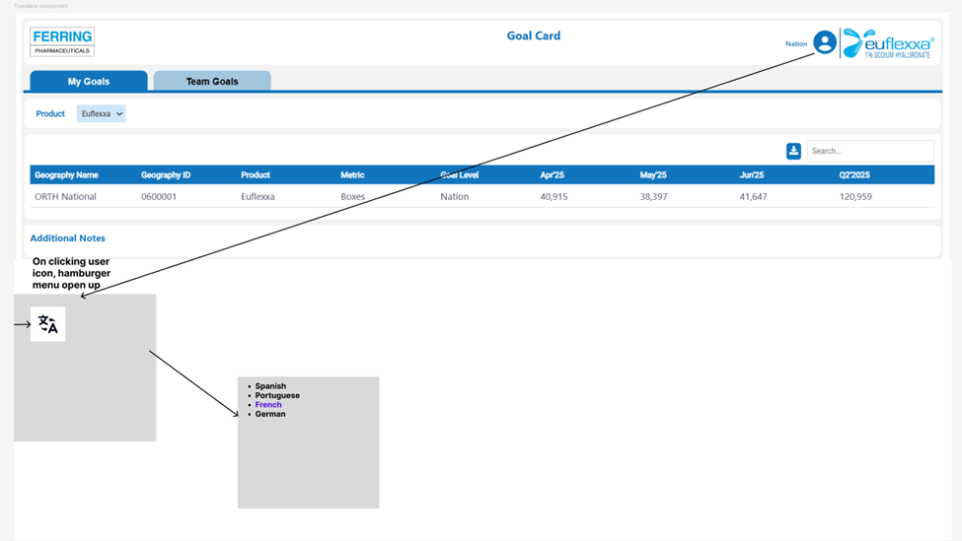
Visual Mockups - Translate Component
Tools

Slide 30
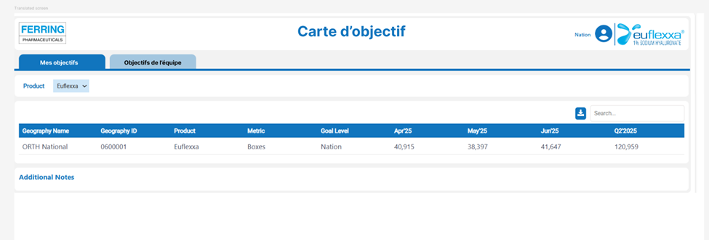
Visual Mockups - Translate Component (Cont.)
Tools
Translated French report

Slide 31
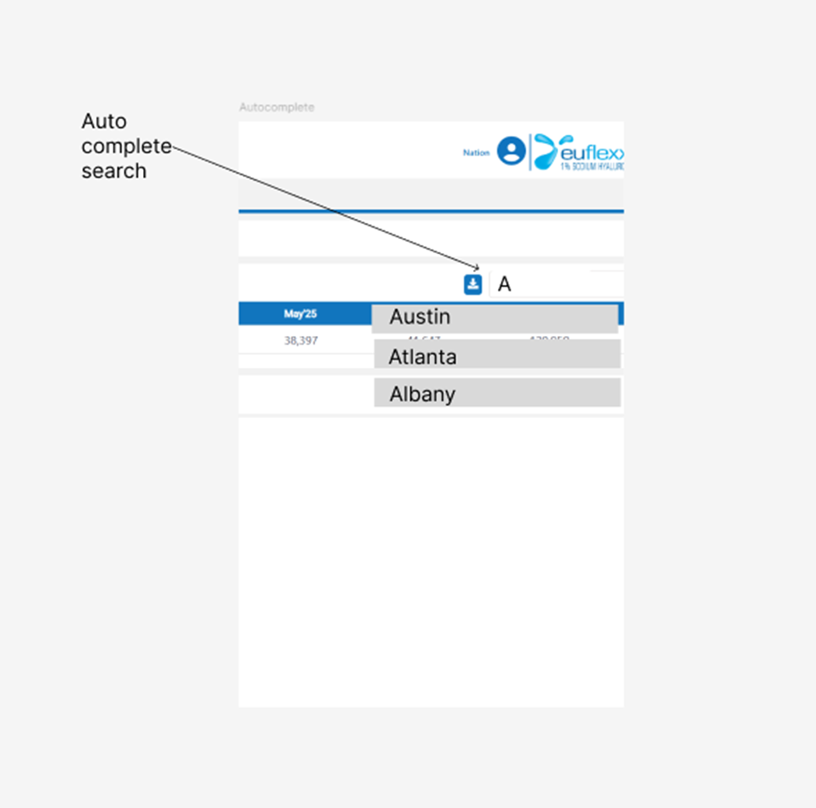
Visual Mockups - Autocomplete Search Functionality
Tools
Autocomplete feature in search option – recommendations provided for better user experience as soon as user starts typing.

Slide 32
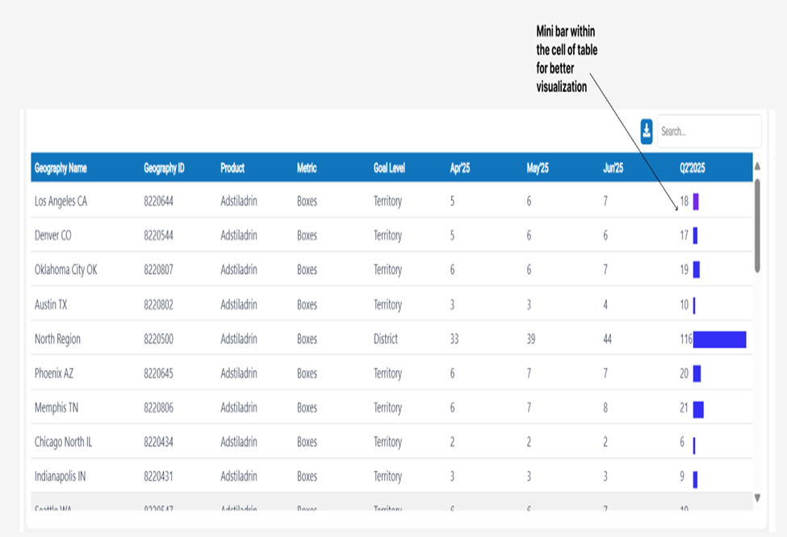
Visual Mockups - Minibar within Cell of Table
Tools

Slide 33


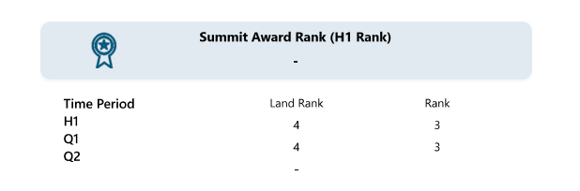
Identified Gaps in React Report
Persona | Client | Components/ Features | React Report | Power BI Report | Comments
Area Sales Director | ITCI-Ferring | Leaderboard |  |  | Leaderboard Table/Chart
Leadership Table is not available in the React reports
(Source: ITCI Scorecard)

Slide 34
Identified Gaps in React Report
Persona | Client | Components/ Features | React Report | Power BI Report | Comments
Area Sales Director | ITCI-Ferring | Box |  |  | Pre-eligibility/Post eligibility Box in Team Summary
Two boxes showing Pre-Eligibility and Post-eligibility earning are not there in the team summary of React reports (scorecard)
(Source: ITCI Scorecard)

Slide 35
Identified Gaps in React Report
Persona | Client | Components/ Features | React Report | Power BI Report | Comments
Area Sales Director | ITCI-Ferring | Performance Summary |  |  | YTD Performance Summary
The component showing Year-to-Date performance summary in the Scorecard is missing in the react report
(Source: ITCI Scorecard)

Slide 36
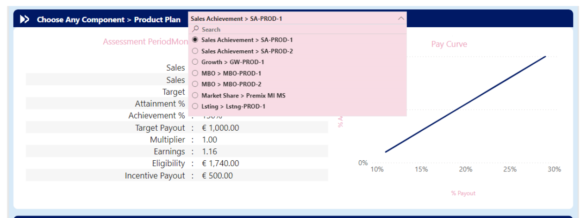
Identified Gaps in React Report
Persona | Client | Components/ Features | React Report | Power BI Report | Comments
Sales Rep | NNIO-Ferring | Searchable Dropdown |  |  | For Choosing Product Plan (based on component)
Searchable dropdown widget for selecting Product plan from available options is not present in the react reports
(Source: NNIO Scorecard)

Slide 37
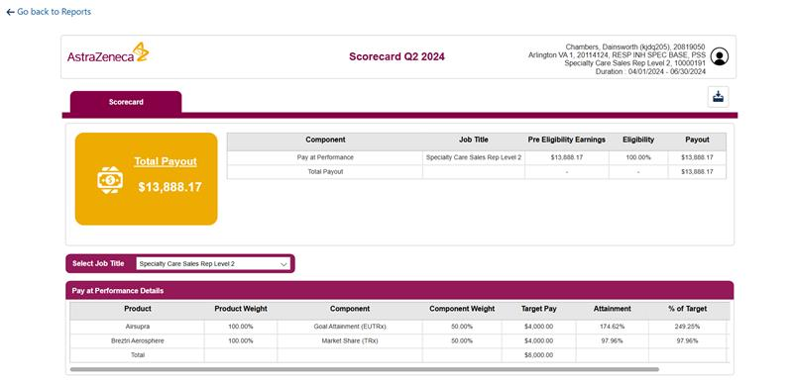
Identified Gaps in React Report
Persona | Client | Components/ Features | React Report | Power BI Report | Comments
Sales Rep | AZ-Ferring | Download Button |  |  | Scorecard/Goalcard Download
(Source: AstraZeneca Scorecard)

Slide 38
Insights from Different Business Teams
Client Name | POC | Questions asked | Findings
AstraZeneca | Bhargavi (A5736) | How is report layout decided? Is there any new component added recently as per client requirement? Is there any pattern observed where some component is given more importance in report? How much % similarity is present in multiple reports? Could you tell how download functionality works in reports ? In what formats reports can be downloaded and only tables can be downloaded or entire report ? | As per client requirement No No Similarity is above 90% Pdf and excel format both works, and entire report can be downloaded
NNIO | Bhavesh (A7007) | Could you Walk us through the report ? Can color of components or report change ? | Understanding of different components No, request entertained through client's end only
ITCI | Surbhi (A2698) and Deepshikha (A7849) | What all components are there in ITCI report? Is export to pdf option available in reports ? Is download option available in all types of reports ? Entire report can be downloaded? | Similar components as react – No gaps identified in Goalcard Pdf downloads available in both monthly and weekly reports , except chart and comments everything else gets downloaded Download option available for all PBI reports Excel download is available in weekly reports only and only tables gets downloaded

Slide 39



Understanding IC Implementation
Key Contributors to Our Insights:
Mazhar Hussain Ansari
Jaya Almadi
Apoorv Garg
Key Questions Explored:
1. Types of Report Client Asks For:
Report Type | Reports (Persona) | Importance
DTR (Dynamic Tabular Report) | Eligibility and IC Master Table (HO) | For detailed data review
UI Based | Goal Card (Field) Scorecard (Field) Rank Report (Field) What-If Calculator (Field) Input/Output Validation Report (HO) | Interactive performance visualization
SFDC (SalesForceDotCom) | Payroll Report (HO) | Custom reports

Slide 40




Understanding IC Implementation (Cont.)
2. Data Needed for Various IC process
Goal Related Data
Sales Data
HR Data (For Eligibility)
IC Plan Detail
3. Frequency of IC Plan Changes:
4. Evaluating Metrics for Report
Adjustments to team size or Goal Methodology
Change in eligibility criteria or business rules
Quarterly (Generally)
Shift in performance expectation
Performance
Data Accuracy
UI Quality
Ease of Implementing Changes
5. Standardization
Large clients need frequent customization due to dynamic requirements.
Standardization suits smaller projects with stable, simpler needs.
"Golden Image" project supports standardization for smaller engagements.

Slide 41



Understanding IC Implementation (Cont.)
6. Key Pain Points in Current IC process
Re-runs due to Data Inaccuracy
Dependency and Bandwidth Issue
Collaboration between Business and Technical Teams
7. KPIs
Budget Utilization
National Attainment
Insights
Breakdown of how teams/roles are performing
Product Performance
8. Expectation from Stakeholders
Field
Interactive, Non-monotonous Reports
HO
Data
Actionable Insights
Key Highlights

Slide 42
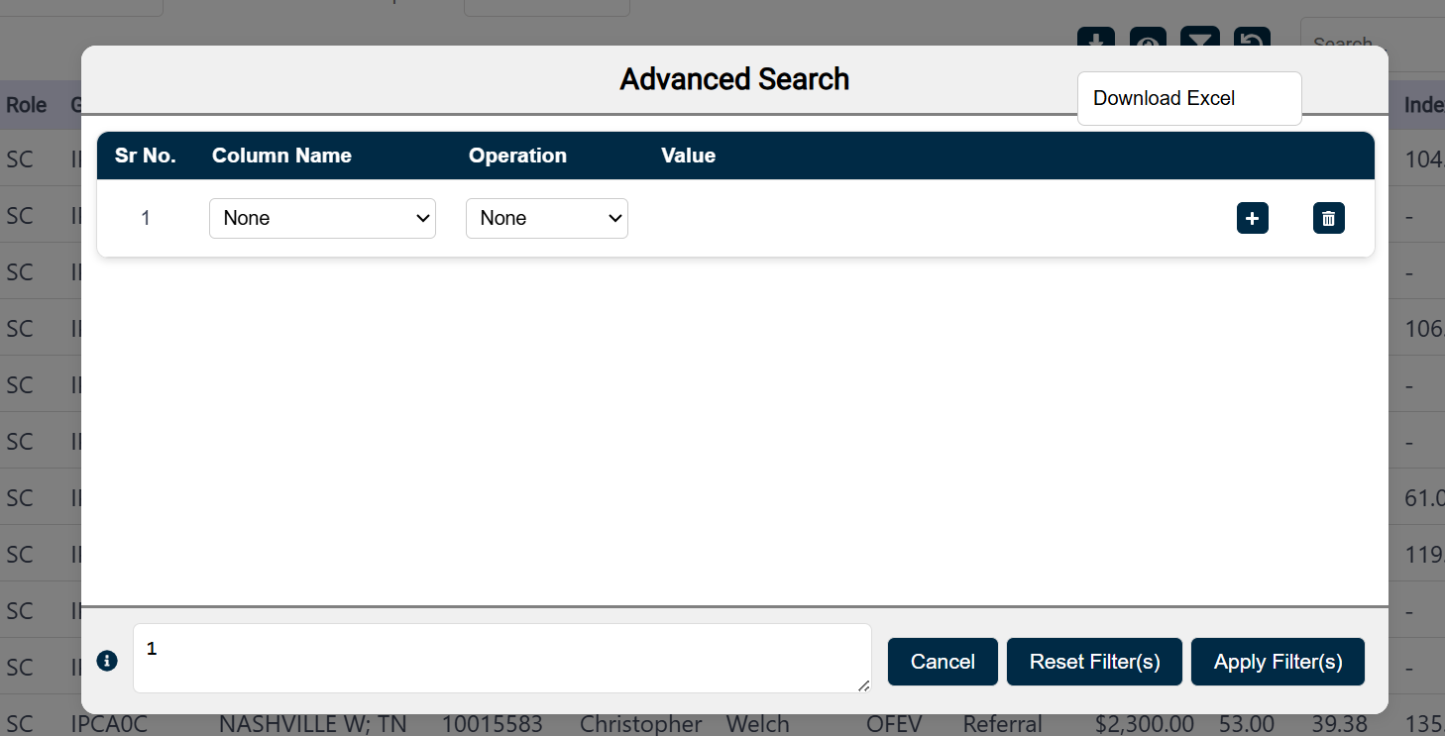
Identified UI/UX Issues
Download excel visible bug on clicking filters
Tools
(Source: BI Scorecard)

Slide 43
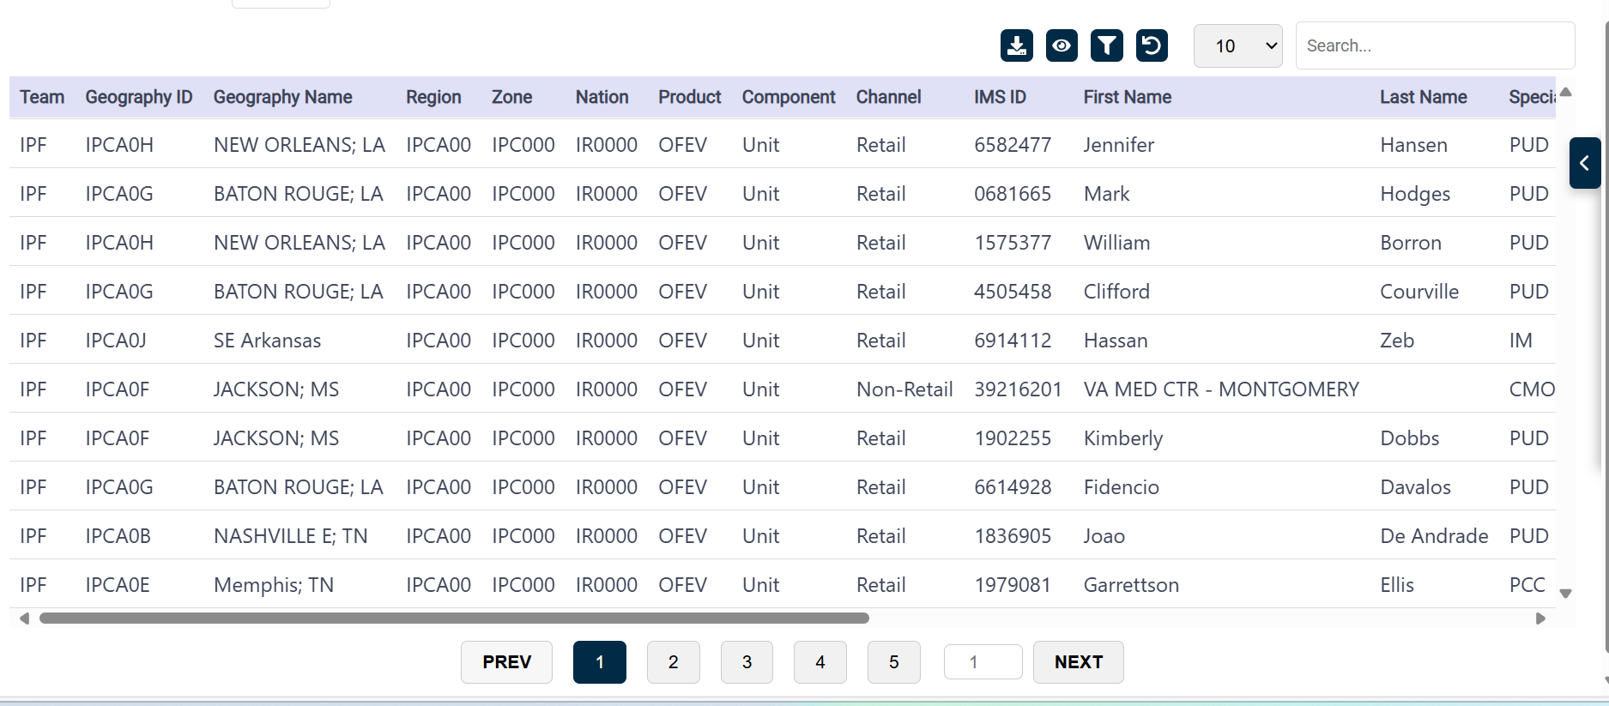
Identified UI/UX Issues (Cont.)
Clustered unnecessarily on previous next page numbers
Tools
(Source: BI Scorecard)

Slide 44
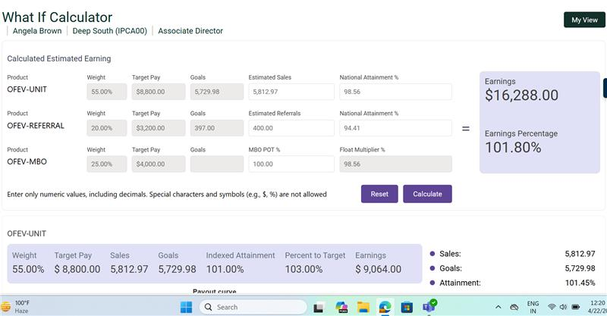

Identified UI/UX Issues (Cont.)
What if instruction should be in a red/blue to highlight the instruction.
Tools
(Source: BI What-If Calculator)

Slide 45
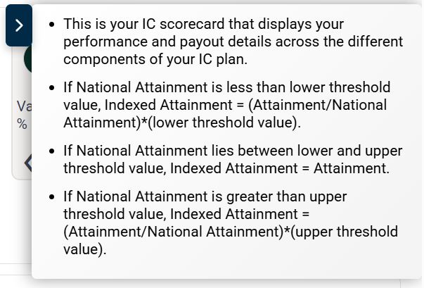
Identified UI/UX Issues (Cont.)
Create Tabs in RHS panel for better readability and user experience.
Tools
Basic Details
Conditions
(Source: Ferring Scorecard)

Slide 46
Conclusion
Key Takeaways:
React reporting framework serves numerous needs and but still has some gaps.
A component based approach can address- 80% of use cases with minimal customization
Identified gaps include some variations w.r.t. Power BI reports and UI/UX bugs/improvements
Proposed Improvements include: some modifications in the current components and addition of new components
Next Goals:
Documentation of current framework
Industry standard documentation that could be shared across client teams

Slide 47
Conclusion
Key Takeaways:
Visual Mockups for suggested modifications and new components
Types of reports required and their specific data needs
Identified pain points and opportunities to standardize processes
Metrics and outcomes essential for both field and home office teams
Call to Action:
Engage with stakeholders to refine the processes
Initiate pilot projects (like GI) to test standardized solutions

